Slide 1
Lecture 13
Static vs Dynamic Memory Allocation
malloc(), calloc(), free()
Reading Assignments:
  Chapter 9, Section 9

Slide 2
Static Memory Allocation
If the size of array is known before compilation, we do
Memory
a[0]
int a[3];
a[1]
a[2]
How about if the number of elements we want is unknown?

Slide 3
Dynamic Memory Allocation

Slide 4
Problem
What do you do if:–
  … the size of an array is not known until run time?
  OR
  … a function must return an array that it creates?
How can we manipulate variable-length arrays and pass them around our programs?
Answer:–
  Use dynamically allocated storage in The Heap!
CS-2303, A-Term 2012
Dynamic Memory Allocation

Slide 5
Dynamic Memory Allocation
int *a = NULL;
int numbers;
printf(“How many elements you want?\n”);
scanf( “%d”, &numbers);
a
Memory
a
/* memory allocation */
a = (int *) malloc (numbers*sizeof(int));

Slide 6
pointer - * and &
What does these operator use for?
  *
  &
What is the difference given initialize int *a, b;
  *a = b;
  b = &a;

Slide 7
array - initialize
int a[5] = { 1, 2, 3, 4, 5};
int a[] = {1, 2, 3, 4, 5};
int a[7] = {1, 2, 3, 4, 5};
int a[5]; a = {1, 2, 3, 4, 5};
int *a = {1, 2, 3, 4, 5}
printf(“%d”, a[3]);

Slide 8
array - initialize
int a[2][3] = { 1, 2, 3,
4, 5, 6};
int a[2][3] = { { 1, 2, 3 },
{4, 5, 6 } };
int a[2][3] = { { 1, 2 },
{3, 4, 5 } };
int a[5][5] = { { 1, 2, 3 },
{4, 5, 6 } };

Slide 9
array - initialize
int a[][] = { { 1, 2, 3 },
{4, 5, 6 } };
int a[][3] = { { 1, 2, 3 },
{4, 5, 6 } };
int a[2][] = { { 1, 2, 3 },
{4, 5, 6 } };

Slide 10
Agenda
Review: pointer & array
Relationship between pointer & array
Dynamic memory allocation

Slide 11
array = pointer
int a[5] = {5, 4, 3, 2, 1}; int *p = a; int *q = p+3;
p is a pointer to first element of a
*q
*a
*a + 3
*(a+3)
p[2]
q[1]

Slide 12
Example
int a = { 5, 4, 3, 2, 1}; int *p = a;
for(int i=0; i<5; i++) {
printf(“%d”, a[i]);
printf(“%d”, *(a+i));
printf(“%d”, *p++);
}

Slide 13
pointer > array
int a[2][2] = { 1, 2, 3, 4};
int *p = &a[0][0];
for(int i=0; i<4; i++) {
printf("%d", *p++);
}

Slide 14
array != pointer
array cannot assign new value
compiler will allocate memory while declaring an array
array has fixed size wile pointer is more dynamic

Slide 15
Definition — The Heap
A region of memory provided by most operating systems for allocating storage not in Last in, First out discipline
    I.e., not a stack
Must be explicitly allocated and released
May be accessed only with pointers
    Remember, an array is equivalent to a pointer
Many hazards to the C programmer
CS-2303, A-Term 2012
Dynamic Memory Allocation

Slide 16
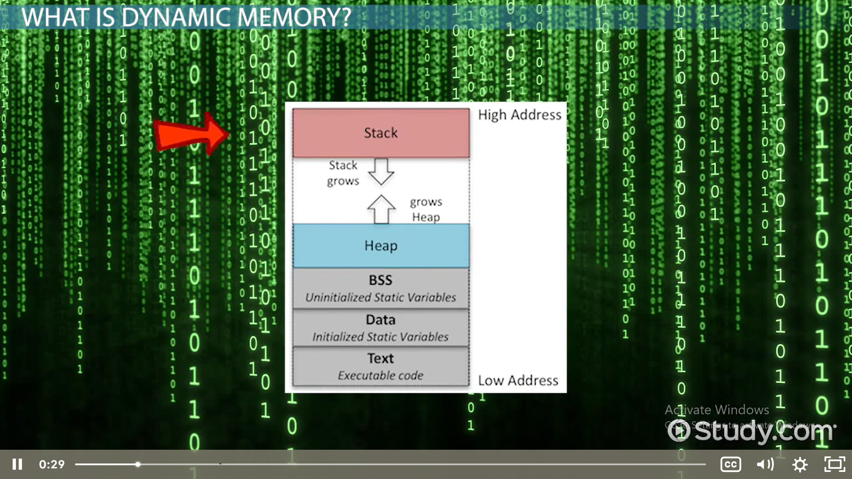

Slide 17
Dynamic Data Allocation
0xFFFFFFFF
stack
(dynamically allocated)
SP
This is The Heap
heap
(dynamically allocated)
address space
global and static
data
program code
(text)
PC
0x00000000
CS-2303, A-Term 2012
Arrays and Pointers

Slide 18
Dynamic Memory Allocation
malloc
calloc
Take one parameter: void *malloc(object_size); | Take two parameters: void *calloc(n, object_size);
Return a pointer to the starting address of the allocated memory Or Return NULL | Return a pointer to the starting address of the allocated memory Or Return NULL
Storage is not initialized | Storage is initialized to zero

Slide 19
Dynamic memory allocation
In order to acquire storage during program execution, C provides calloc() and malloc() (available in stdlib.h) for dynamic memory allocation
To allocate a contiguous memory space for n object of a type, use
  calloc(n, object_size)
calloc() returns a pointer to the starting address of the allocated memory if enough memory can be found; otherwise, a NULL value is returned; the storage gained is initialized to zero

Slide 20
Dynamic memory allocation (cont’)
malloc() returns a pointer to the starting address of the allocated memory if enough memory can be found; otherwise, a NULL value is returned; its format is
  malloc(object_size)
The function prototypes of calloc() and malloc() are
    void *malloc(size_t)
    void *calloc(int, size_t)
The storage set aside by malloc() is NOT initialized

Slide 21
Dynamic memory allocation (cont’)
As the pointers returned by malloc() and malloc() is of type void *, they can be assigned to other pointers without casting
Space allocated by calloc() and malloc() is not released on function exit (but it is released on program exit) and has to be released by calling a system library function free() (available in stdlib.h)
The prototype for free() is
  void free(void *ptr);

Slide 22
Dynamic memory allocation (cont’)
Since the size of a data object of a particular data type is machine-dependent, sizeof() is often used when malloc() or calloc() is called, e.g.,
  int *a;
  … /* get memory space for 5 integers */
  if ((a = (int *) calloc(5, sizeof(int)))==NULL)
  {
  printf(“calloc() failed\n”);
  exit(1);
  }
  ...
  free(a); /* free the space */
  ...

Slide 23
Dynamic Memory Allocation
int *a = NULL;
int i, numbers;
printf(“How many elements you want?\n”);
scanf( “%d”, &numbers);
/* allocate memory space */
if ((a=(int *) malloc(numbers*sizeof(int))) == NULL){
printf(“Not Enough Memory Space!\n”);
exit(-1); /* end the program */
}
for (i = 0; i < numbers; i++) a[i] = i*i;
/* free memory space */
free(a);

Slide 24
Allocating Memory in The Heap
See <stdlib.h>
void *malloc(size_t size);
void free(void *ptr);
void *calloc(size_t nmemb, size_t size);
void *realloc(void *ptr, size_t size);
malloc() — allocates size bytes of memory from the heap and returns a pointer to it.
    NULL pointer if allocation fails for any reason
free() — returns the chunk of memory pointed to by ptr back to the heap
    Must have been allocated by malloc() or calloc()
free() knows size of chunk allocated by malloc() or calloc()
Segmentation fault and/or big-time error if bad pointer
CS-2303, A-Term 2012
Dynamic Memory Allocation

Slide 25
Notes
calloc() is just a variant of malloc()
malloc() is analogous to new in C++ and Java
    new in C++ actually calls malloc()
free() is analogous to delete in C++
    delete in C++ actually calls free()
    Java does not have delete — uses garbage collection to recover memory no longer in use
CS-2303, A-Term 2012
Dynamic Memory Allocation

Slide 26
Example usage of malloc() and free()
#include <stdlib.h>
int PlayGame(int board[], int arraySize);
int main(){
int s, t;
int A[];
s = …; /* determine size of array from input */
A = malloc(s * sizeof(int));
…;
t = PlayGame(A, s);
…
free(A);
return t;
}
CS-2303, A-Term 2012
Dynamic Memory Allocation

Slide 27
Alternate version of malloc() and free()
#include <stdlib.h>
int PlayGame(int *board, int arraySize);
int main(){
int s, t;
int *A;
s = …; /* determine size of array from input */
A = malloc(s * sizeof(int));
…;
t = PlayGame(A, s);
…
free(A);
return t;
}
CS-2303, A-Term 2012
Dynamic Memory Allocation

Slide 28
Generalization
malloc() and free() are used …
  whenever you need a dynamically sized array
  whenever you need an array that does not follow last in, first out rule of The Stack
Valid in all versions of C
  See p. 167 of K&R (§7.8.5)
CS-2303, A-Term 2012
Dynamic Memory Allocation

Slide 29
malloc vs. calloc
void *malloc(size_t #ofBytes)
    Takes number of bytes as argument
    Aligned to largest basic data type of machine
        Usually long int
    Does not initialize memory
    Returns pointer to void
void *calloc(size_t #ofItems, size_t sizeOfItem)
    Takes number of # of items and size as argument
    Initializes memory to zeros; returns pointer to void
calloc(n, itemSize) ≡ malloc(n * itemSize)
    Plus initialization to zero
CS-2303, A-Term 2012
Dynamic Memory Allocation

Slide 30
realloc()
void *realloc(void *p, size_t newSize)
  Changes the size of a malloc’ed piece of memory by allocating new area (or changing size of old area)
  May increase or decrease size
  Data copied from old area to new area
    If larger, extra space is uninitialized
  free(p) – i.e., frees old area (if new area different from old)
  Returns pointer to void of new area
  See p. 252 of K&R
Rarely used in C programming!
CS-2303, A-Term 2012
Dynamic Memory Allocation

Slide 31
Definition – Memory Leak
The steady loss of available memory in Heap due to program forgetting to free everything that was malloc’ed.
  Bug-a-boo of most large C and C++ programs
If you overwrite or lose the value of a pointer to a piece of malloc’ed memory, there is no way to find it again!
  Automatically creating a memory leak
Killing the program frees all memory!
CS-2303, A-Term 2012
Dynamic Memory Allocation

Slide 32
Agenda
Review: pointer & array
Relationship between pointer & array
Dynamic memory allocation

Slide 33
sizeof()
return size of variable or type in byte
char i; char *p; char a[5];
printf("%d ", sizeof(char));
printf("%d ", sizeof(i));
printf("%d ", sizeof(p));
printf("%d ", sizeof(a));

Slide 34
malloc()
void *malloc(size_t size);
return a pointer to the first byte of a region of memory of size size that has been allocated from the heap
int *a = (int *)malloc(5 * sizeof (int));
int *a = (int *) malloc(5 * sizeof (a[0]));

Slide 35
calloc()
void *calloc(size_t num, size_t size);
allocate memory the size of which is equal to num * size.
int *a = calloc(5 , size of (a[0]));

Slide 36
realloc()
void *realloc(void *ptr, size_t size);
change the size of the previously allocated memory pointed to by ptr to that specified by size.
int *a;
…
a = realloc(a, 5*sizeof(a[0]));

Slide 37
free()
void free(void *ptr);
return the memory pointed to by ptr to the heap
int *a = malloc(5 * size of (a[0]));
…
free(a);

Slide 38
pro & con
pro
  efficiently use of memory
  size is dynamic
con
  memory management is not done by compiler

Slide 39
Dynamic Two-Dimensional Arrays
Array of pointers, one per row
    Each row is a one-dimensional array
int x, y; /* x = #rows, y = #columns */
int **B = calloc(x, sizeof(int *));
for (i = 0; i < x; i++)
B[i] = calloc(y, sizeof(int));
…
/* to access element of row i, column j */
B[i][j]
CS-2303, A-Term 2012
Dynamic Memory Allocation

Slide 40
Why does this work?
int **B means the same as
int *B[];
    I.e., B is an array of pointers to int
    Therefore, B[i] is a pointer to int
But if A is a pointer to int,
then A[j] is the jth integer of the array A
Substitute B[i] for A
Therefore, B[i][j] is the jth integer of the ith row of B
CS-2303, A-Term 2012
Dynamic Memory Allocation

Slide 41
Why does this work? (continued)
When expression contains B[i][j], compiler generates code resembling
    int *temp = B + i;
    *(temp + j);
… in order to access this element
CS-2303, A-Term 2012
Dynamic Memory Allocation

Slide 42
Alternative Method
int x, y; /* x = #rows, y = #columns */
int **B = calloc(x, sizeof(int *));
int elements[] = calloc(x*y, sizeof(int));
for (i = 0; i < x; i++)
B[i] = &elements[i*y];
…
/* to access element of row i, column j */
B[i][j]
Why does this work?
Exercise for the student!
CS-2303, A-Term 2012
Dynamic Memory Allocation

Slide 43
Arrays as Function Parameters
(again)
void init(float A[], int arraySize);
void init(float *A, int arraySize);
Are identical function prototypes!
Pointer is passed by value
I.e. caller copies the value of a pointer of the appropriate type into the parameter A
Called function can reference through that pointer to reach thing pointed to
Most C programmers use pointer
notation rather than array notation
CS-2303, A-Term 2012
Dynamic Memory Allocation

Slide 44
Arrays as Function Parameters
(continued)
void init(float A[][], int rows, int columns);
void init(float **A, int rows, int columns);
Not Identical!
Compiler complains that A[][] in header is incompletely specified
    Needs to know number of columns
    As if constant!
Must use pointer notation in header or declaration
In body of init, A[i][j] is still acceptable
CS-2303, A-Term 2012
Dynamic Memory Allocation

